Slide 1
CIVITAS DESTINATIONS
TOURISM, MOBILITY AND SUSTAINABILITY CHALLENGE
Claudio Mantero, Horários do Funchal
CIVITAS DESTINATIONS Coordinator

Slide 2


CIVITAS in figures
5 phases
(2002-2020)
85 CIVITAS
Cities
19 CIVITAS
projects
18 living
lab projects
Measures are reaching 52.4 million citizens
Total budget: approx. EUR 250 million
Total EC contribution: approx. EUR 180 million
700 measures tested in more than 10 years

Slide 3
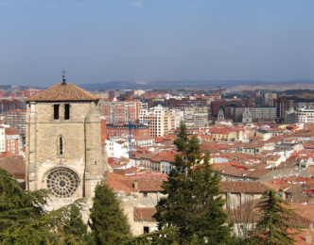
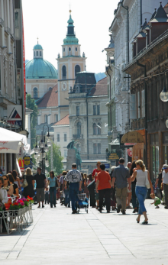
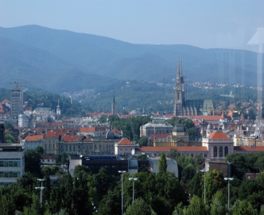


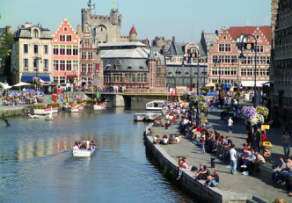
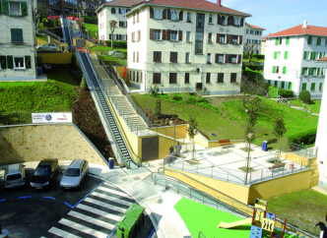
CIVITAS way to work
Test New Solutions
1
Knowledge
Base on Clean Urban Transport
Living labs
Exchange Good Practices
2
How did you do it?
Convince Politicians
3
How did you win them over?

Slide 4
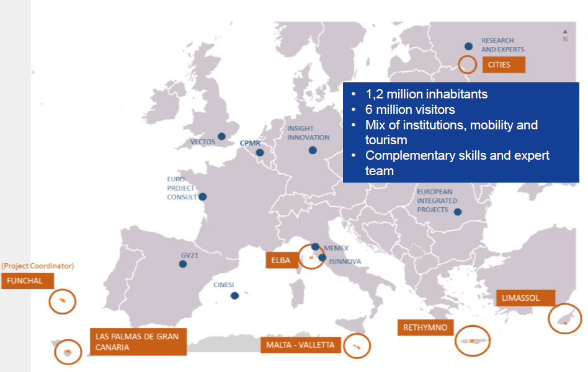
CIVITAS DESTINATIONS Project
Implement a set of mutually reinforcing innovative mobility solutions in six urban/regional laboratory areas
The project gathers 29 partners from 12 European countries, plus China
From 1st September 2016 to 31st August 2020 (48 months duration)
Total budget of 19.9 M€ of which 17.8 M€ of EC Contribution

Slide 5
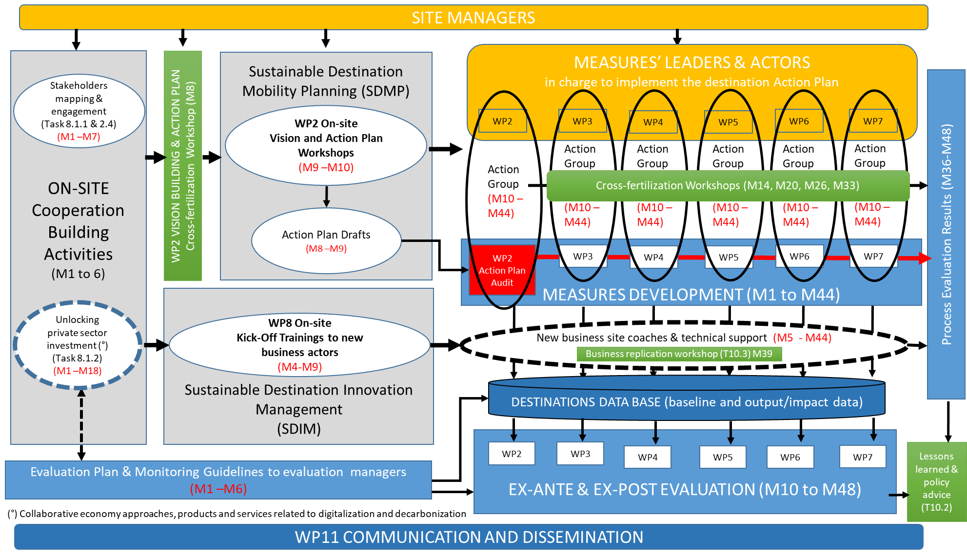
CIVITAS DESTINATIONS Project

Slide 6
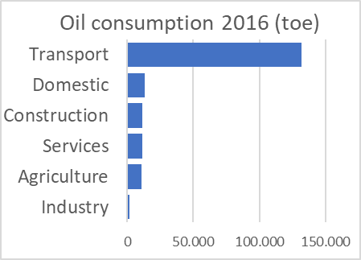
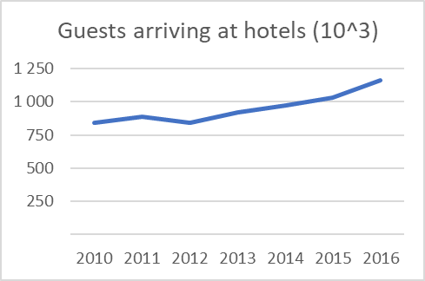
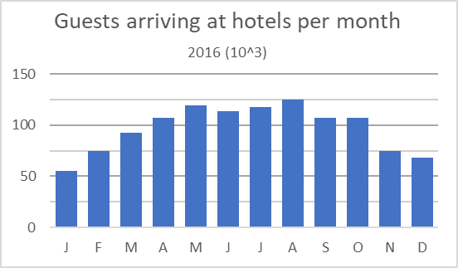
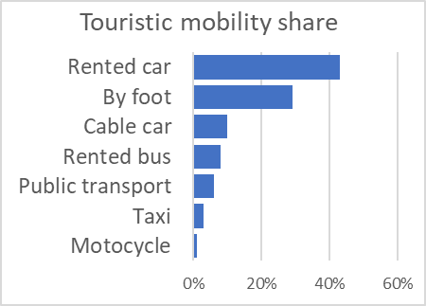
Figures of Madeira Island

Slide 7
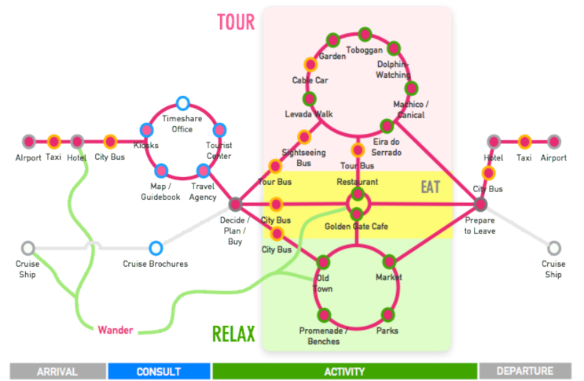
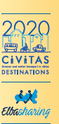

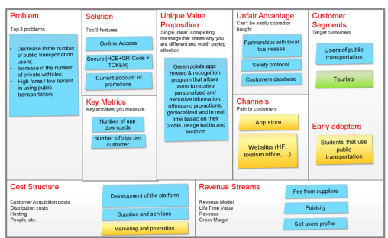
Main topics and main achievements at high level
Overarching approach to urban and regional problems, including a supra-municipal perspective
  Urban and regional authorities and actors work together to drive the change on sustainable mobility regulation and activity
Development of mobility solutions serving both residents and tourists needs
  Tourist and residents have different transport needs, both use the same mobility system and cohabitation must improve
Project economy-sharing driven
Development of business models to guarantee lasting impacts of the measures

Slide 8

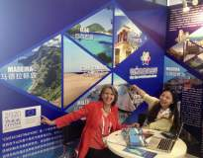
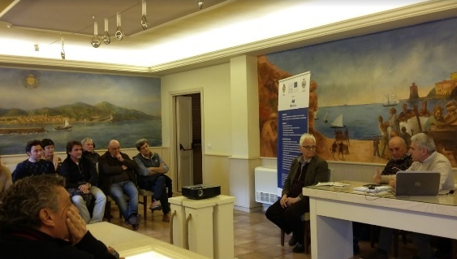
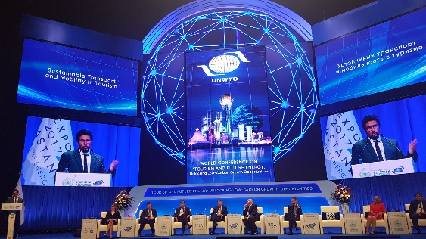
Main topics and main achievements at high level
Working group representing over 150 coastal and insular regions following the project as observers with CPMR leading role
Link to China, the most promising touristic market of the future, to strength international cooperation
GV21 and other strategic partners at research and mobility level
New formats for assembling stakeholders and co-creation processes
CO-creation SUMP strategy was implemented in 6 cites/regions with remarkable positive results
Information and technologies up calling such Gaming, incentives, mobile apps, integrated tools

Slide 9
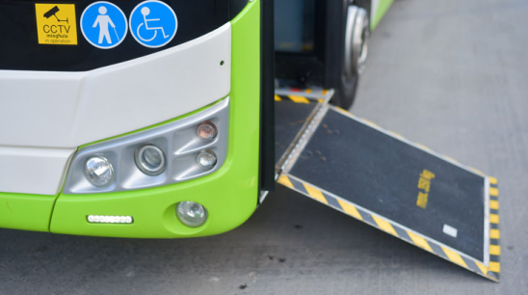
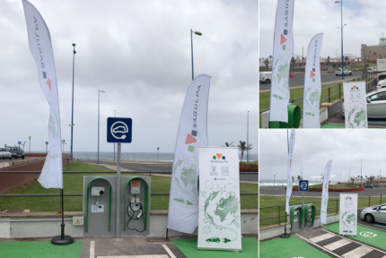
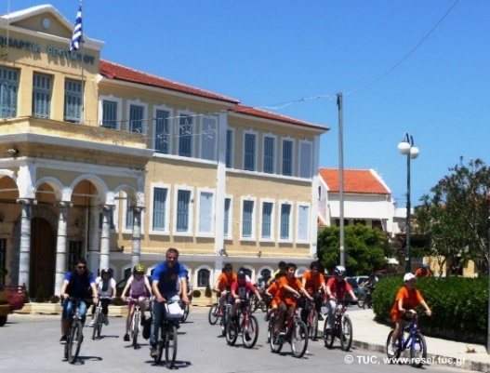

Which future for mobility and tourism?
Local measures to address global problems
  Brave and long run urban mobility plans
  Emergent new mobility businesses
  Electro mobility
  Integrated, innovative and accessible PT
  Need for a clear regulation framework with needed enforcement
  ITC and public services
  Excellence as a strong incentive for the “hosting culture”
  More livable cities/less cars
  Common Stakeholder strategy based on results
  Common and integrated communication plans

Slide 10
Islands and Investments
  Transport mobility in island suffer high seasonality. Sharing economies and innovative cooperative management tools can be a solution. A common strategy for island at EU level can be vital to leverage investment in tourism and sustainable economies.
Islands and financing instruments
  Road maintenance and transport infrastructures are vital for island transport and local economy. A financial support is needed to support the over cost raised by the insular condition.
Islands and regulations
  Mobility and transport at island dimension need a long run integrated, territorial dimension approach with a broad strategy involving main local economies (logistic), tourism, energy, safety and security in an integrated way (ISMP –Island Sustainable Plan?)

Slide 11
Islands and Emissions Trading Scheme
  The closed economies of EU islands can be the perfect laboratory to push for sustainable strategies in all fields using innovative consumption technologies and related incentive schemes.
Islands and innovation
Natural assets in Island are especially relevant. Innovation has to be focused on main insular assets (tourism, culture, ocean, agriculture..). It is also essential to find integration platforms with neighbour areas to empower the positive effects and to create critical mass on relevant markets.

Slide 12
http://civitas.eu/destinations
https://www.destinationsplatform.eu/
Thank you!
Claudio Mantero
Horários do Funchal, Transportes Publicos
www.horariosdofunchal.pt
+351 291705555
claudiomantero@horariosdofunchal.pt

