Slide 1
Circular Economy and Insularity
George KREMLIS
Honorary Director
European Commission
DGENV

Slide 2
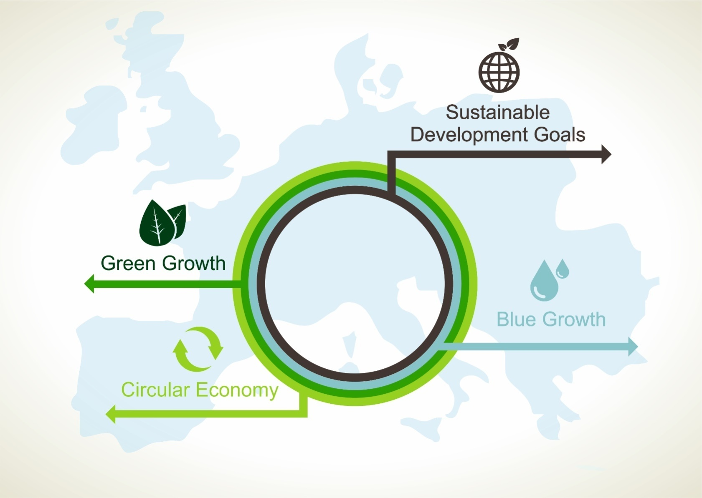

Slide 3
Description of the initiative
Initiative of DG ENV in cooperation with DG REGIO and islands states/regions
Is coordinated with DG ENER clean energy for EU islands initiative
Consists of a series of conferences held in islands states/regions which aim at promoting circular economy in the islands and at discussing the role of islands in the territorial cohesion policy
Is complementary with other relevant initiatives, such as the International conference "Towards a circular economy and sustainable tourism in islands" (Brussels, 11 April 2018) organised in the framework of the Interreg MED Blue islands project
Notes:
International conference "Towards a circular economy and sustainable tourism in islands" objectives: enhance mutual learning opportunities between islands and regions dealing with seasonal variations of waste and marine litter; build consensus on shared path towards material resource resiliency, circular economy and sustainable tourism on islands.
Interreg Med Blueislands project: gather 8 major and 55 small islands of the Mediterranean in a systematic effort to identify and mitigate the effect of the seasonal variation of waste generated on Mediterranean islands as an effect of tourism.
Project partners:
BLUEISLANDS project’s leader is Cyprus Ministry of Agriculture, Rural Development and Environment.
The project brings together partners from 8 countries:
• ACR+
• Autonomous University of Barcelona
• Balearic islands Government
• CoNISMa - National Inter-University Consortium for Marine Sciences
• EA Eco-Entreprises
• INSULEUR - Network of the Insular CCI of the European Union
• Municipality of Mykonos
• Primorje and Gorski Kotar county
• Region of Crete
• Rhodes Municipality
• Sardinia Region
• Taormina Etna Consortium
• Wasteserv Malta (ACR + member)
Website: https://blueislands.interreg-med.eu/news-events/events/detail/actualites/towards-a-circular-economy-and-sustainable-tourism-on-islands/

Slide 4
Legal basis
Art. 174 of the TFEU on economic social and territorial cohesion: particular attention shall be paid, among others, to regions which suffer from severe and permanent natural or demographic handicaps such as the island regions (including island States in their entirety, subject to the necessary criteria being met - Declaration on Art. 174)
Art. 170 of the TFEU on trans-european networks: the EU action in this field shall take account in particular of the need to link island, landlocked and peripheral regions with the central regions of the EU

Slide 5
Why promoting circular economy in islands is important?
Circular economy is a policy and legal framework within which islands deserve particular attention
On the one hand, islands can exploit well natural resources, on the other hand, in islands local resources are scarce and the capacity for waste management is limited
Notes:
Natural resources: On the one hand, islands can exploit well natural resources from their continental shelves and within their exclusive economic zone (EEZ) and continental shelve, which can provide valuable mineral, food and energy resources to them and to the EU in general.

Slide 6
What challenges?
Waste: seasonal spikes in waste generation and reaching the scale to make local recycling cost-efficient
Access to external resources: islands do not benefit from the economies of scale of the EU single market, of a large home market or from easily connected networks and besides they are penalised because of the high transport costs
Climate change vulnerability and water scarcity

Slide 7
How to face these challenges?
It is essential for islands to manage their own scarce resources (both in terms of materials, waste and water) sustainably, to become even more resource and energy efficient, and to protect their environment and the surrounding marine environment

Slide 8
Why circular economy is part of the solution?
The switch to a circular economy would reduce islands' imports of energy and natural resources because local resources will be used more efficiently and at the same time this would benefit their environment
Furthermore, it would create jobs for the thousands of people living on islands and growth with direct benefits for the local economy
Notes:
Jobs creation: Small and medium-sized enterprises (SMEs) form a backbone of island economies and the circular economy represents important business opportunities for them. SMEs would benefit from reduced costs through using less resources and selling their waste and also through exploiting increased demands for recycling, repair, remanufacturing, re-using and secondary raw materials. This will also create green jobs. SMEs are traditionally active in these business areas and can play a key role in the shift towards a more circular economy on islands.

Slide 9
How to make circular economy in islands a reality?
EU Policy: e.g. 2018 Circular economy package
EU Funds: e.g. Cohesion Policy 2014-2020: about EUR 150 billion are allocated to objectives with a direct relevance to the circular economy, including EUR 5.5 billion focused on waste management
EU cooperation frameworks: e.g. EU Strategy for the Adriatic and Ionian Region can help to further strengthen cooperation and to further mobilize funding sources for the development of common circular economy projects; it has a reference to islands.
Notes:
2018 circular economy package: As part of its continuous effort to transform Europe's economy into a more sustainable one and to implement the ambitious Circular Economy Action Plan, in January 2018 the European Commission adopted a new set of measures, including:
A Europe-wide EU Strategy for Plastics in the Circular Economy and annex to transform the way plastics and plastics products are designed, produced, used and recycled. By 2030, all plastics packaging should be recyclable. The Strategy also highlights the need for specific measures, possibly a legislative instrument, to reduce the impact of single-use plastics, particularly in our seas and oceans. A public consultation is open until 12th February. To reduce the leakage of plastics into the environment, the Commission has adopted a new proposal on Port Reception Facilities, to tackle sea-based marine litter and published a report on the impact of the use of oxo-degradable plastic, including oxo-degradable plastic carrier bags, on the environment.
A Communication on options to address the interface between chemical, product and waste legislation that assesses how the rules on waste, products and chemicals relate to each other.
A Monitoring Framework on progress towards a circular economy at EU and national level. It is composed of a set of ten key indicators which cover each phase – i.e. production, consumption, waste management and secondary raw materials – as well as economic aspects – investments and jobs - and innovation.
A Report on Critical Raw Materials and the circular economy that highlights the potential to make the use of the 27 critical materials in our economy more circular
EU Funds: Source: http://ec.europa.eu/regional_policy/en/newsroom/news/2015/12/12-02-2015-cohesion-policy-supports-the-circular-economy
Adriatic Ionian Strategy:
The implementation of a life-cycle approach to marine litter and diffuse pollution sources are priorities for the environmental pillar of the Strategy and are very relevant for circular economy.
The next Forum will take place in Catania-Italy on 24-25 May under the Italian Presidency. Main topic will be transport and energy connectivity. There will be also parallel sessions on financing opportunities for each pillar of the Strategy, including environment.

Slide 10
State of the art
Three conferences held in in Corsica – France, Heraklion/Crete-Greece and La Valletta-Malta, attended also by high level representatives of the Commission and of islands States and regions (e.g. DG ENV Calleja-Crespo attended the Conference in Corsica)
The next conference will take place again in Chania/Crete on 20-21 September 2018

Slide 11
Main outcome: Heraklion – Crete Declaration
Declaration on Circular Economy for the Insular Territories at the Mediterranean (Heraklion – Crete Conference Declaration)
Has been signed by the islands states and regions participating in the Circular Economy - Territorial Cohesion – Insularity Conference held in Heraklion, Crete
The Declaration is available at: http://www.europarl.europa.eu/RegData/questions/reponses_qe/2017/004628/P8_RE(2017)004628(ANN1)_XL.pdf

Slide 12
Heraklion- Crete Declaration: main objectives
Underlines the importance to further strengthen circular economy and to further increase the role of islands in the EU policy and related funding programmes
recommends to the Commission to develop a strategy for island regions similar to the Strategy for the Outermost Regions
decides the establishment of a EGTC on island regions of the Mediterranean based in Crete, which will operate as a tool to support any initiatives or project/programme proposals on behalf of the signatories (not established yet)

Slide 13
Malta Political Declaration, 18/5/2017.
The Clean Energy islands Initiative
Commission and 14 MS launched the 'Clean Energy for EU Islands' initiative to:
Accelerate the clean energy transition
Reduce dependency and costs of energy imports
Embrace modern and innovative energy systems
Improve air quality and lower greenhouse gas emissions
Overwhelming endorsement at Inaugural Forum in Chania in September 2017

Slide 14
Objectives
Islands as innovation leaders for integrating local renewable production, storage facilities and demand response;
Islands to demonstrate how decarbonisation creates resilient energy systems via reduced reliance on fossil fuel imports, the protection of the local environment, and autonomy over its energy supply
Islands to show how an energy transition can be a driver for economic development, by creating local jobs, provide new business opportunities, and supporting self-sufficiency of the island community.

Slide 15
Clean Energy for EU Islands Initiative Support
Secretariat
    Start of operation in June, public launch at EUSEW 2018
    Capacity building for decarbonisation plans on islands, benchmarking, communication, Forum and events, web portal
Island Facility to be set up to support comprehensive energy transition in the preparatory and implementation phase under Horizon 2020

Slide 16
Next steps
Clean Energy Package: creating the right legal framework (renewables, consumers and stability for investment)
Engagement with stakeholders at different levels
Providing technical assistance via the Secretariat and Islands Facility
Providing financial assistance for demonstration projects under the new MFF

Slide 17
Conclusions
Circular economy is a priority for islands because of their specific geographical features and policy, funding and cooperation tools are available in order to make circular economy in islands a reality
The Circular Economy -Territorial Cohesion – Insularity Initiative and the Crete and Malta Declarations show that there is strong support from islands states and regions for the promotion of circular economy and clean energy (RES)
The EU Funds Regulations post 2020 can represent a good opportunity to address these Declarations requests to further increase the role of islands in the EU funding programmes in the circular economy, clean energy and other key fields for islands. Cooperation between the MS and regions concerned and competent DGs in this regard is very important.

Slide 18
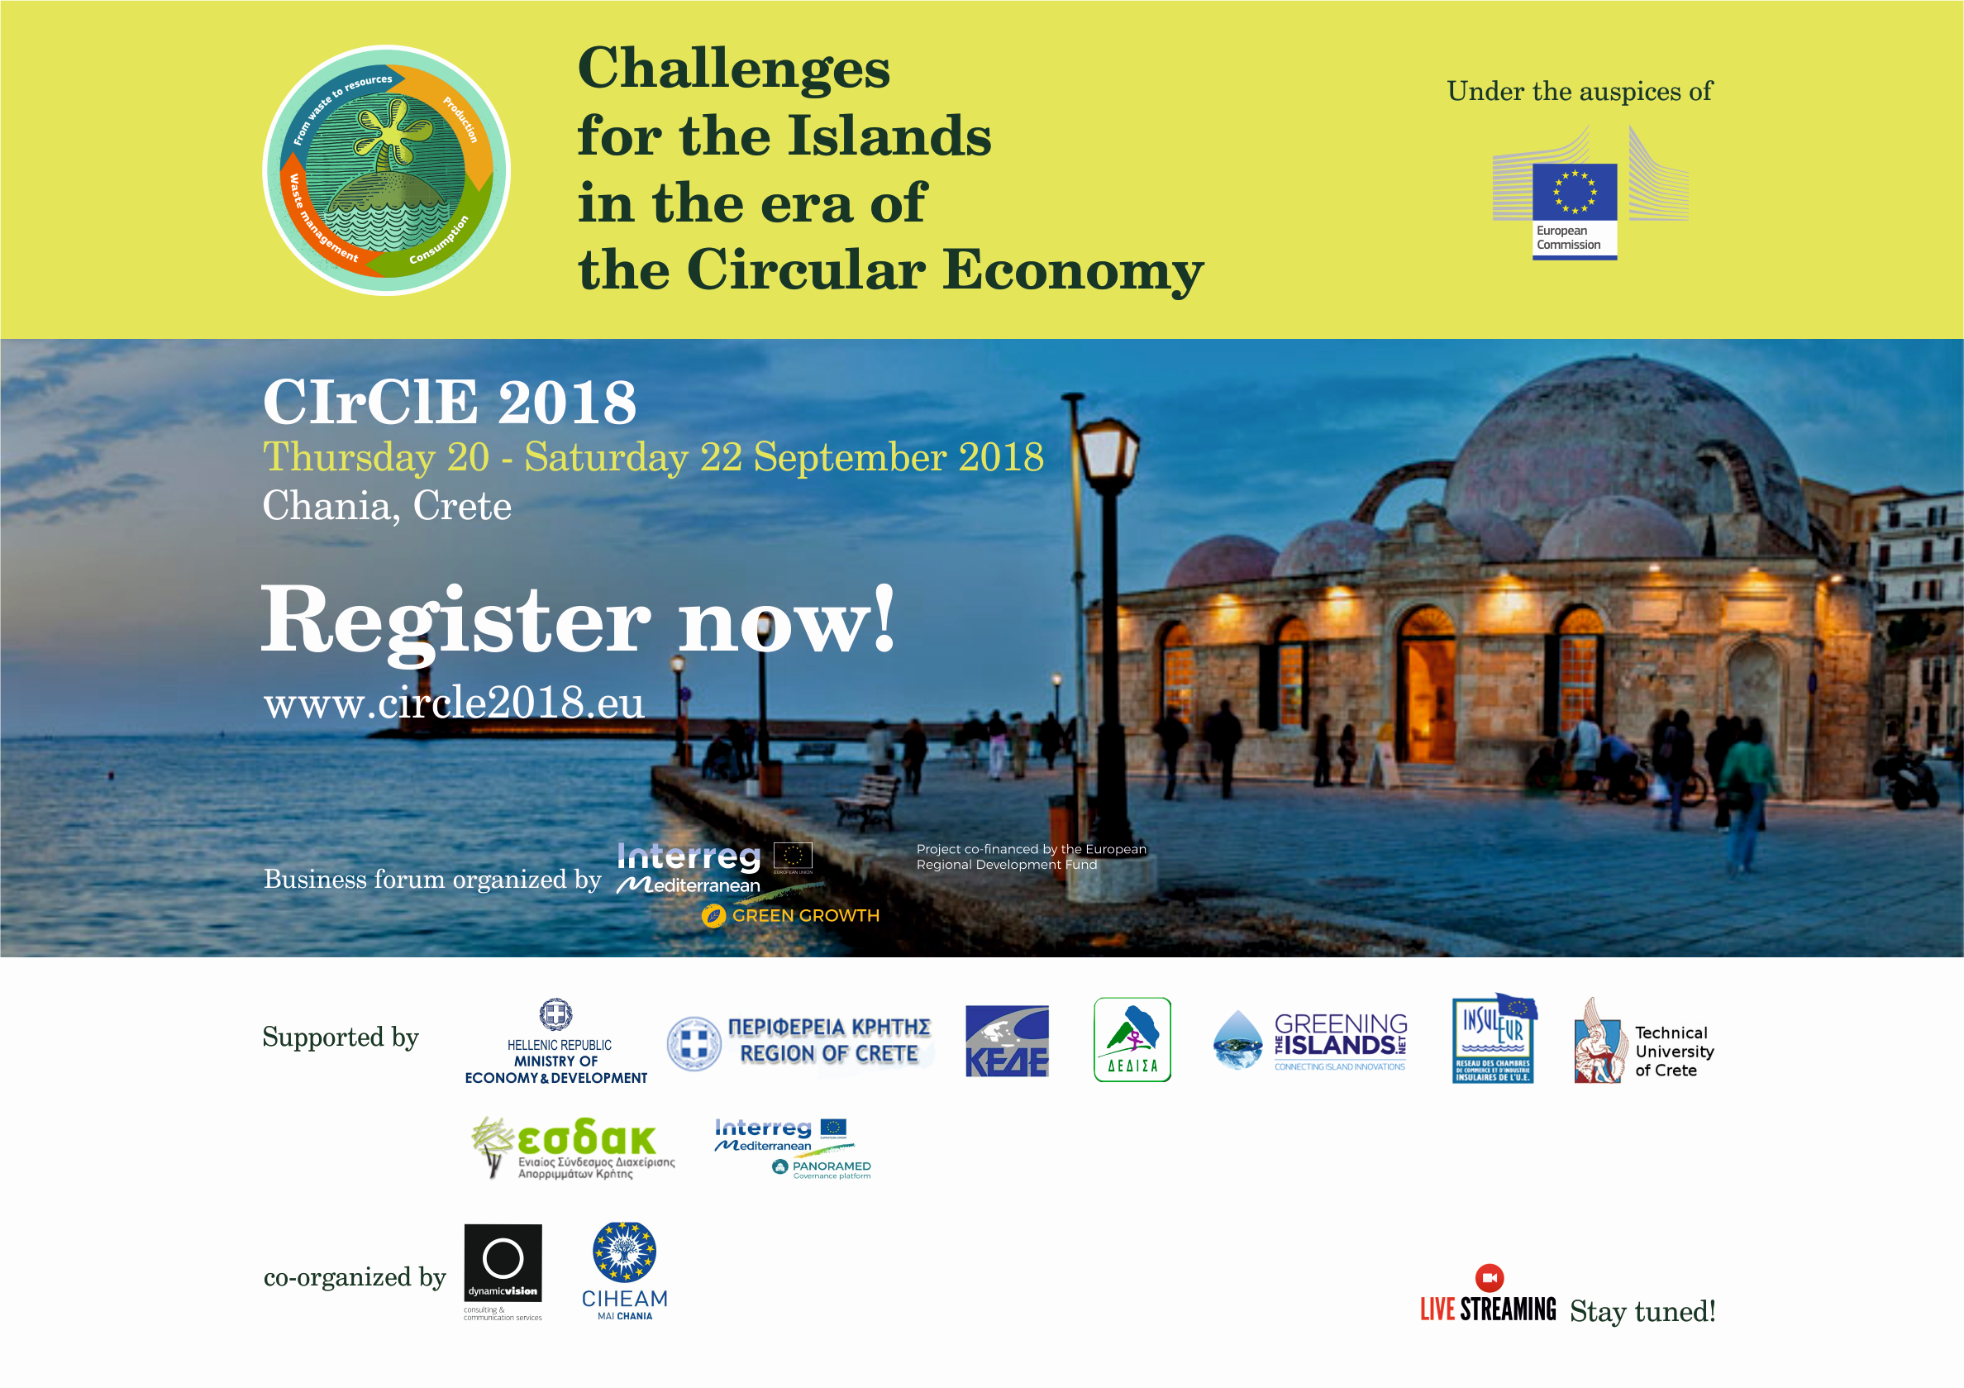

Slide 19
Thank you for your attention!
Georges Kremlis
European Commission, DG ENV
Honorary Director
Active Senior for circular economy in islands
Georges.kremlis@ext.ec.europa.eu
Disclaimer: "The views expressed are purely those of the writer and may not in any circumstances be regarded as stating an official position of the European Commission."

