Slide 1
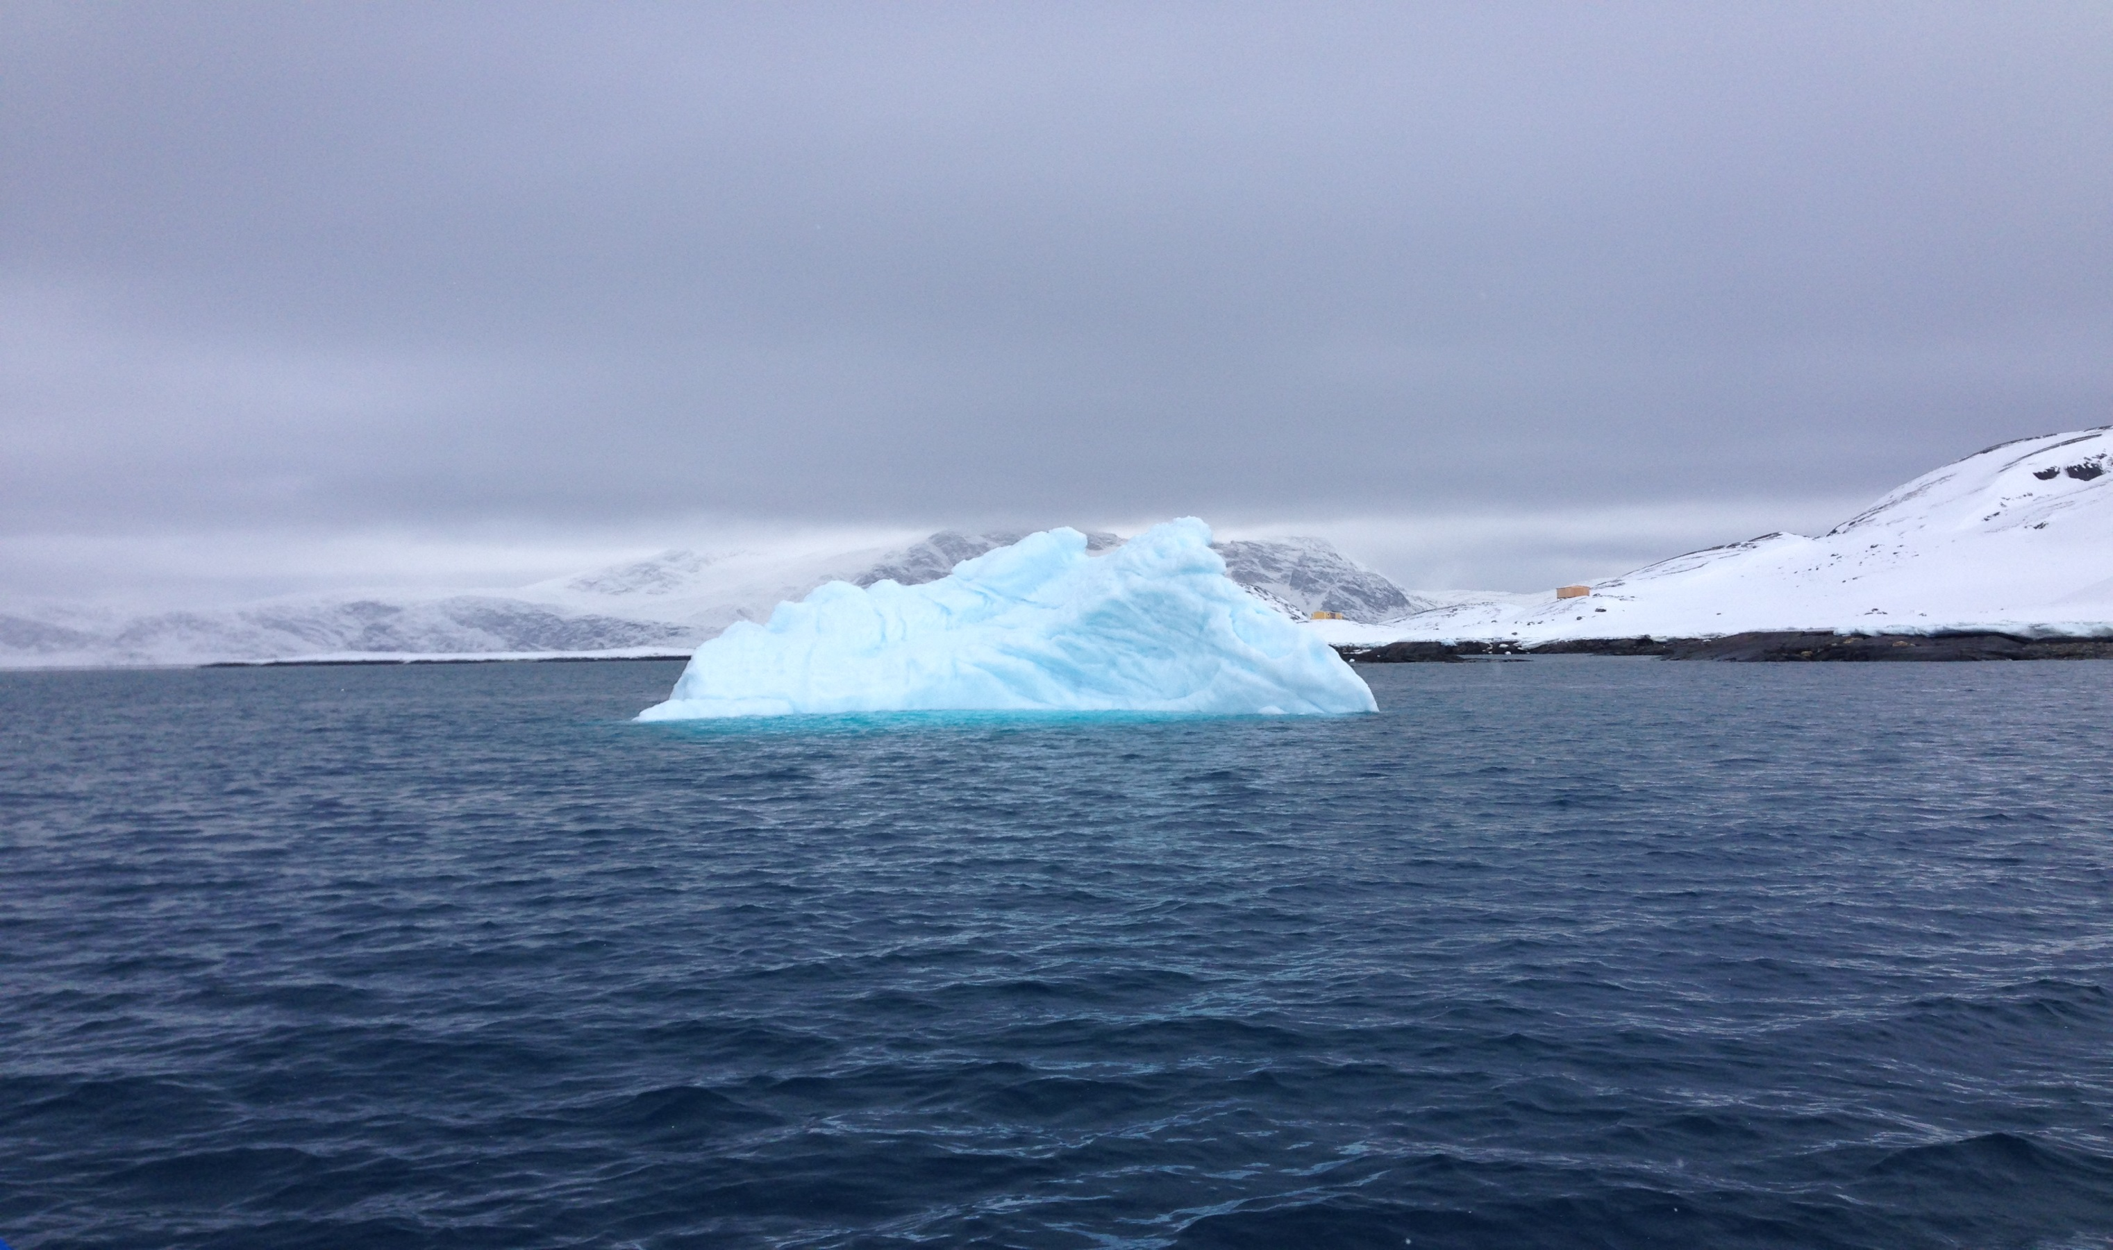



Nordic Entrepreneurship Islands
Christian Vintergaard
Christianvintergaard
@chr_vintergaard

Slide 2

The Nordic Entrepreneurship Island project
  Nordic Entrepreneurship Islands is a pre-project in 7 selected Nordic islands with the purpose to:
  Map and analyse the spread of entrepreneurship education in upper secondary and higher education.
  Ensure one newly established student business is supported through a micro grant.
  Analyse the development opportunities and resources for start-ups initiated by students
  Estimate the expected penetration rate of entrepreneurship education and student start-ups during a 5 year time horizon.
  The project is based on experience, models, programmes, materials etc. that already exist in the Nordic countries.
Notes:
Særlig analyse på beskæftigelse:
I undersøgelsen deltager 89 startups. Heraf 50 startups, der har modtaget et Mikrolegat og en kontrolgruppe på 39 startups, der har fået afslag.

Slide 3

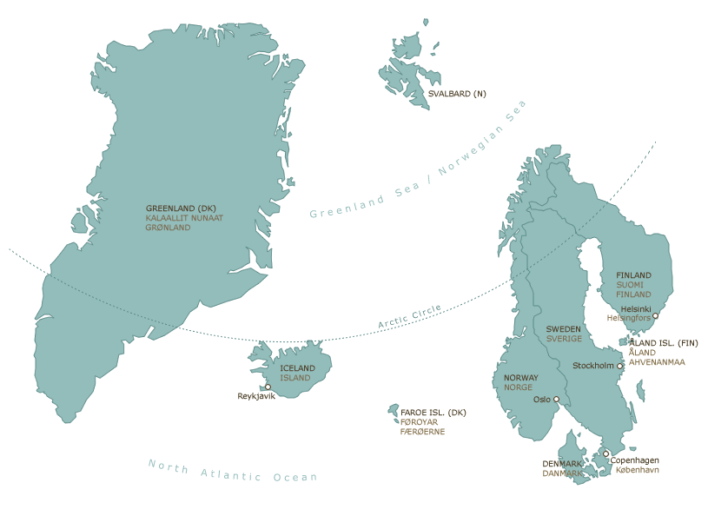
The Nordic Entrepreneurship Island project
A pilot-project in 7 selected Nordic islands
  The project addresses:
  The demographic, educational and new business venture challenges on the islands.
  The opportunities and potentials arising from an increased focus on entrepreneurship education and start-up capital for student start-ups on the islands
  The expected penetration rate of entrepreneurship education and student start-ups during a 5 year time horizon.

Slide 4
Challenges
  Depopulation & youth unemployment
    Most of the Nordic islands in the project are suffering from depopulation - especially young people who have high career aspirations and wishes for a higher education.
    The Nordic islands also suffer from youth unemployment which in most islands is 2 or 3 times as high as overall unemployment.
  Few jobs
    Nordic islands are challenged by having too few jobs, and the companies that disappear are not replaced by new entrepreneurial businesses.
    In the Faroe Islands many young people go abroad to study and about half of them never return, presumably because there is a lack of knowledge-intensive workplaces in the Faroe Islands.
    Existing jobs are replaced by new technologies, new demands etc.
  Entrepreneurs & entrepreneurship education
    Generally, entrepreneurs and innovative employees are missing.
    There is currently no widespread entrepreneurship development in the North.
    The education system trains the young people to the present (and past jobs) and makes them seek a higher education.
Notes:
Særlig analyse på beskæftigelse:
I undersøgelsen deltager 89 startups. Heraf 50 startups, der har modtaget et Mikrolegat og en kontrolgruppe på 39 startups, der har fået afslag.

Slide 5
Possibilities
  The number of new entrepreneurs can be influenced by regional and national initiatives.
  Entrepreneurs are very immobile "people" (Source: The Danish Business Authority).
  Entrepreneurship can be affected (relatively cheaply) through education and microfinance to student-run start-ups.
  There is evidence that an effort to enhance entrepreneurial competences among young students has a great effect on:
    Competence / dissemination.
    The number of student start-ups
Notes:
Særlig analyse på beskæftigelse:
I undersøgelsen deltager 89 startups. Heraf 50 startups, der har modtaget et Mikrolegat og en kontrolgruppe på 39 startups, der har fået afslag.

Slide 6
Data collection
Macro level
National strategy
Meso level
Educational institution strategy
Micro level
Upper secondary education and VET
Tertiary educations – course descriptions and ”Stjernemodel”
Cases

Slide 7
General conclusions for all islands
The analysis
No / limited prior data available for mapping entrepreneurship in the educational sector
The definition of entrepreneurship education is defined by The Danish Foundation for Entrepreneurship
Findings:
Transportation is a big issue
Limited implementation of entrepreneurship education
Only very few student entrepreneurs
Industrial change – from ”living of the land / sea”
Awareness of the present challenges
Resourceful people
No / limited resources for entrepreneurship education
No / limited resources for student entrepreneurs
No / limited resources for entrepreneurship teachers
National and regional strategies have huge impact
Great potential on each island
Notes:
Særlig analyse på beskæftigelse:
I undersøgelsen deltager 89 startups. Heraf 50 startups, der har modtaget et Mikrolegat og en kontrolgruppe på 39 startups, der har fået afslag.

Slide 8
General conclusions for all islands
The development of the penetration rate for entrepreneurship education develops according to an S-curve.
100 %
Penetration
0 %
Time
Notes:
Særlig analyse på beskæftigelse:
I undersøgelsen deltager 89 startups. Heraf 50 startups, der har modtaget et Mikrolegat og en kontrolgruppe på 39 startups, der har fået afslag.

Slide 9
General national recommendations
National strategies for entrepreneurship education are important
  a cross-ministerial collaboration
A national operator/ responsible organisation is important
Strong stakeholder relations
Dedicated budget for development and activities
Do not underestimate data – for development in penetration
    Later: impact studies also become important
Entrepreneurship in higher education is the most effective way to foster long-run student start-ups.
Support and collaborate with schools on all levels
There are only few EE activities for teachers
Focus on teacher training from the start
EE as a job creator (start-up organisations, incubators)
Promote EE
The Micro Grants do have an effect, but one should expect a slow start
Synergies across the Islands can be great
Notes:
Særlig analyse på beskæftigelse:
I undersøgelsen deltager 89 startups. Heraf 50 startups, der har modtaget et Mikrolegat og en kontrolgruppe på 39 startups, der har fået afslag.

Slide 10

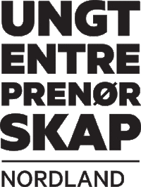


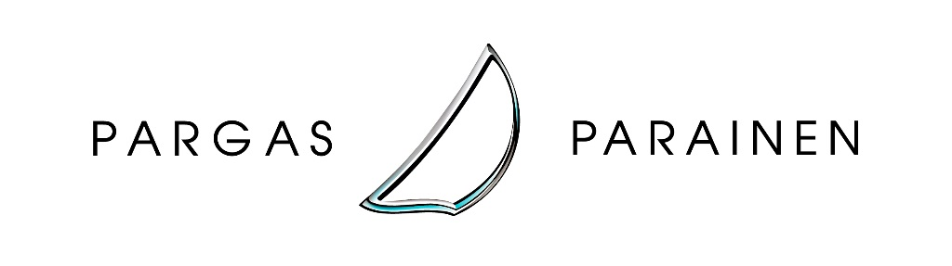

Mapping of the islands
Danish Foundation for Entrepreneurship
Thanks!
Notes:
Særlig analyse på beskæftigelse:
I undersøgelsen deltager 89 startups. Heraf 50 startups, der har modtaget et Mikrolegat og en kontrolgruppe på 39 startups, der har fået afslag.

Slide 11
Nordic Entrepreneurship Islands
Christian Vintergaard
Christianvintergaard
@chr_vintergaard

