Slide 1

Tourism: a distortive factor for the understanding of
Island’s economic realities?
INSULEUR Hearing
8th May 2014, Brussels.

Slide 2
Tourism as an economic driver
In most EU Islands, tourism is a key economic driver
Tourism accounts for - directly or indirectly –a major share of island’s employment and GDP.
This situation gives rise to a number of problems

Slide 3
Tourism is wealth, but...
It is in most cases a strongly seasonal economy
Many jobs it provides are low-skilled and low-paid
It compels public authorities to provide – at a cost – oversized infrastructure and services so as to accommodate the “peak” in the tourist season.
It causes severe pressure on the land, the environment, etc.

Slide 4
Over-reliance on tourism means high vulnerability
The whole island economy is highly vulnerable to any factor which may affect the tourist industry.
These factors can be due to unforeseen external causes which are uncontrollable, e.g.:
EU Air traffic controllers strike
Severe epidemic restricting travel movements
Social or political unrest in the country
International tension in the area...

Slide 5
Tourism as a monoindustry
Tourism is – generally - the economic sector which provides the highest returns in an island.
By contrast, most other sectors tend to attract lower returns for well-known reasons: cost of importing inputs and exporting outputs, small size of local market, lack of economies of scale...
With tourism, the customer comes to the product, when otherwise, the product has to be sent from the island to the customer.
It is therefore very hard to diversify an island economy beyond the tourism sector without some degree of public support.

Slide 6
How can diversification from tourism be supported?
Key EU policies which could support diversification rest largely upon indicators such as GDP/h or Unemployment ( Cohesion Policy, Regional Aid regime...)
But many islands look more “wealthy” than they actually are because of the impact of tourism on their GDP, and therefore attract lower levels of support.
For example: in archipelagos, a few tourist “hot spots” can boost the overall GDP, and hide the economic difficulties of smaller islands and outlying communities (e.g.: South Aegean).

Slide 7
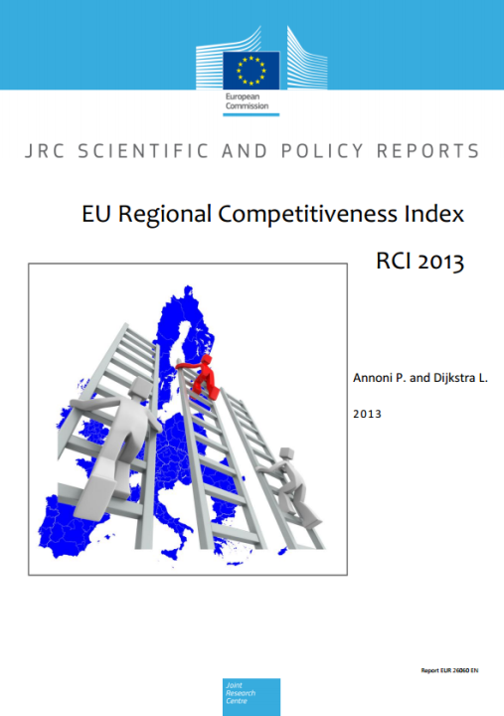
Tourism hides the Islands’ low level of competitiveness

Slide 8
Productivity or competitiveness?
GDP reflects the economic productivity of a given territory, but not its competitiveness.
A Regional Competitiveness Index (RCI) has been created by the European Commission’s Joint Research Centre and DG REGIO, which provides very different conclusions regarding the islands.

Slide 9
The IRC index uses 73 indicators, some at regional and some at national level.
Data from EUROSTAT, OECD, World Bank etc.
It is based upon a much broader variety of criteria: infrastructure, macroeconomic stability, market size, market efficiency, technological readiness, Innovation, business sophistication, health, education, etc.
Use of “functional” Regions (NUTSII level, or aggregated for some urban areas).

Slide 10
What is “competitiveness”, and why assess it?
“Regional competitiveness can be defined as the ability to offer an attractive and sustainable environment for firms and residents to live and work”.
“The project provided with a method to benchmark regional competitiveness and to identify the key factors which would allow a low competitive region to catch-up.”
“RCI can be considered as an overall but synthetic picture of regional competitiveness.”

Slide 11
An indicator not without flaws...
E.G.:
Index is calculated at NUTSII level only. As a consequence, Islands at NUTSIII level are included in mainland areas which are totally different (e.g: Bornholm with Copenhagen)
Accessibility assessed through air traffic... and railways and motorways, which are irrelevant for islands.
Index of “Technological readiness”: the number of individuals who ordered goods on Internet... But many online retailers refuse to deliver in the islands!

Slide 12
An Indicator which is certainly not partial to the Islands
“While islands, mountains and cities are fairly permanent features of a region, this analysis did not want to assume that they would automatically influence competitiveness.”
“… this work does not claim the death of distance or that geography does not matter, but it only considers the impact of distance or geography to the extent that it changes a number of features which are important location factors for firms and enterprises.”

Slide 13
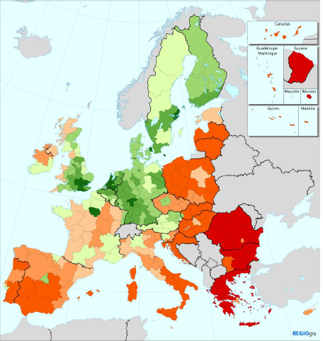
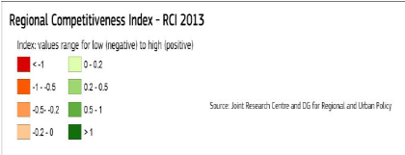

Slide 14
A debatable, but nevertheless revealing instrument.
Key findings:
When their competitiveness is assessed, all island NUTII Regions rank far lower than when GDP is being used.
All islands but one rank in the last quarter of a list of 262 EU regions.
The discrepancy between RCI and GDP can be considerable. (E.g.: Notio Aigaio ranks 136th for GDP, 257th for RCI, Madeira: 107th and 210th).

Slide 15
 | RCI Ranking | GDP Ranking
MT00:Malta | 193 | 148
CY00:Kypros | 163 | 118
ES53: Illes Balears | 188 | 103
ITG1:Sicilia | 235 | 213
ITG2:Sardegna | 222 | 182
FR83:Corse | 195 | 127
FI20 Åland | 90 | 21
GR43:Kriti | 240 | 204
GR41:Voreio Aigaio | 243 | 219
GR22:Ionia Nisia | 249 | 187
GR42:Notio Aigaio | 257 | 136

Slide 16
 | RCI Ranking | GDP Ranking
ES70:Canarias | 199 | 167
PT20:Região Autónoma dos Açores | 228 | 193
PT30:Região Autónoma da Madeira | 210 | 107
FR91:Guadeloupe | 221 | 185
FR92:Martinique | 203 | 184
FR94:Réunion | 239 | 205

Slide 17
Conclusions
The lesson from RCI is that even Islands which appear “rich” in GDP terms (usually because of tourism) seem to remain very uncompetitive in general terms.
The present reliance upon GDP in key EU policies such as Cohesion policy or Regional Aid can prevent Islands from accessing financial means which are necessary to achieve a more diversified, and therefore more sustainable form of development.
Allocating ESIF or setting Regional Aid Guideines on the basis of lagging behind in competitiveness would probably provide a better tool than GDP to address the situation of these territories.

