Slide 1

ENERGY UNION AND SMART ISLANDS
Guest speaker
Ing. Renzo Curmi
Council Member of Gozo Business Chamber
The Gozo Business Chamber

Slide 2
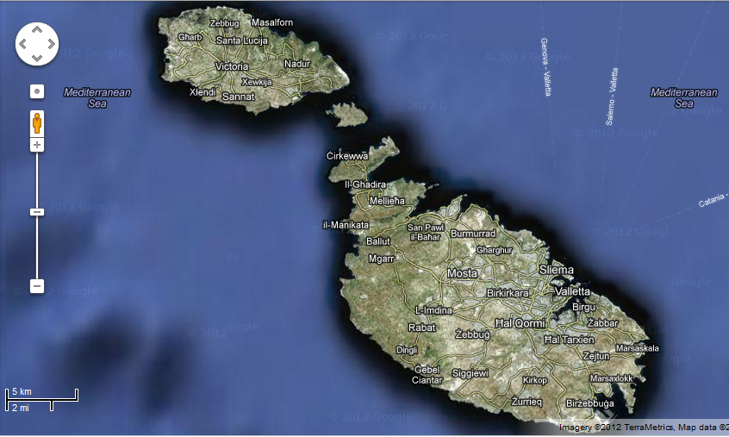
Historical data
1925 - 31 (GOZO)
First “power station” built in Victoria Gozo.
The generating plant consisted of two 44 kVA Diesel Alternator Sets.
In 1931 more equipment was added, bringing the capacity to 94 kVA.

Slide 3
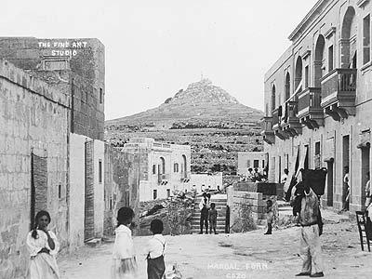
Historical data
1949 (GOZO)
In 1949 a new unit with a capacity of 120 kW was installed in Gozo. This brought the overall capacity to 180 kW.

Slide 4
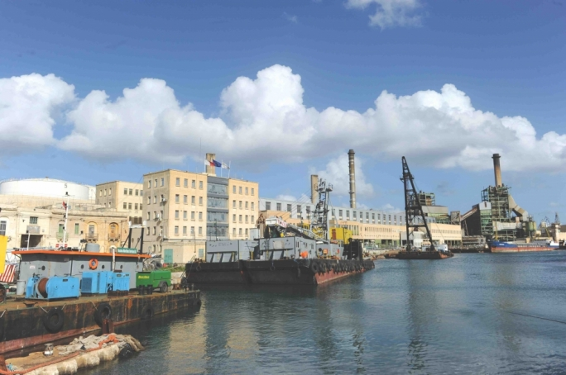
Historical data
1954-1959
It was recommended that it was more viable to serve Gozo from the Power Station in Malta and in 1957 two submarine cables were laid from Marfa to Comino and from Comino to Gozo.

Slide 5
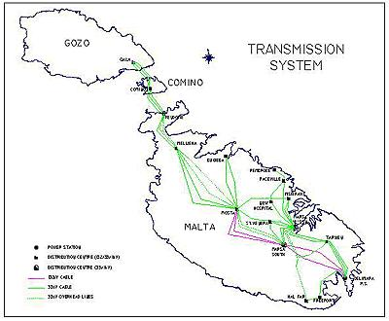
Present situation Today Gozo is supplied with electricity from Malta via three submarine cable circuits which pass over the island of Comino where there is a 33/11kV distribution centre to supply electricity to Comino.

Slide 6
Delimara Power station in Malta provides electrical power to the entire archipelago by means of fossil fuel
Present situation
Units | Commissioned
2 x 60MW Conventional Steam Blr/Tur Units | 1992
2 x 35MW Open Cycle Gas Turbines | 1994
1 x 110MW Combined-Cycle Plant consisting of 2 x 37MW GTs, 2 x HRSG, 1 x 36MW | 1999
8X Wartsila 18V46, 4 stroke medium speed diesel engines, operating in combined cyle mode, with eight heat recovery boilers and one steam turbine - 144MW | 2012

Slide 7
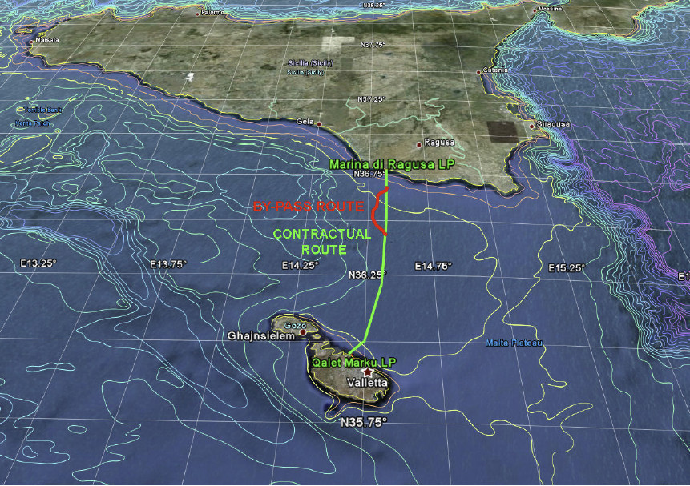
Malta-Italy Interconnector
The 120km Malta-Italy Interconnector was commissioned in April 2015
High voltage alternating current (HVAC) system capable of bidirectional flow of electrical power, rated at 200MW.

Slide 8
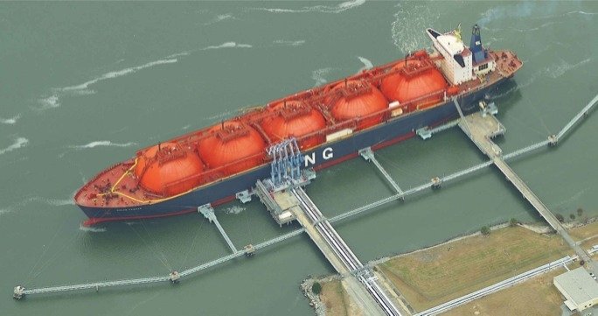
New LNG plant
A new gas-fired power plant and related LNG storage and regasification facilities are currently being developed within the Delimara Power Station by Electrogas Malta. Upon completion of this project, Enemalta will be able to stop using its older oil-fired plants at Delimara, whilst the 2012 plant will be converted to run on natural gas.

Slide 9
New LNG plant
Project | Provide mid-sized FSU to be docked in Delimara, Malta to supply gas from LNG deliveries, and develop a 210 MW IPP.
Gas Off-Takers | The regasified LNG will be supplied to Enemalta's existing 149MW power plant, which will be converted to operate on gas, and also to a new 210 MW independent power plant to be built, owned and operated by ElectroGas.
Project Benefits | Current cost of electricity generation is very high in Malta. This project will significantly lowers Malta's energy costs. Natural gas is a cleaner, less expensive fuel compared to liquid fuels and offers significant economic and environmental benefits for Malta.
Bid Status | ElectoGas Malta Consortium awarded Preferred Bidder status on 13 October 2013.
Project Structure | Gas Supply Agreement (GSA) & Power Purchase Agreement (PPA).

Slide 10
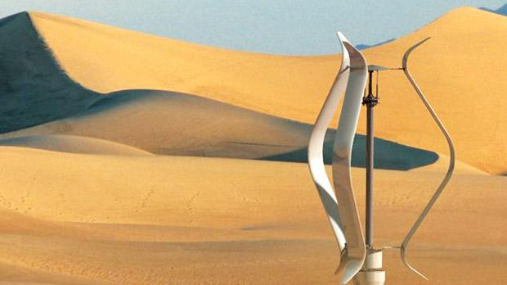
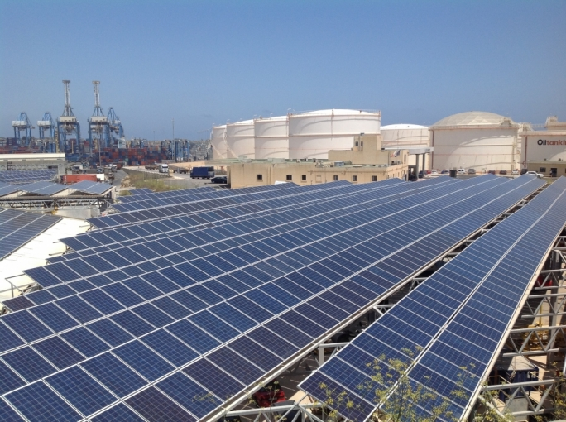
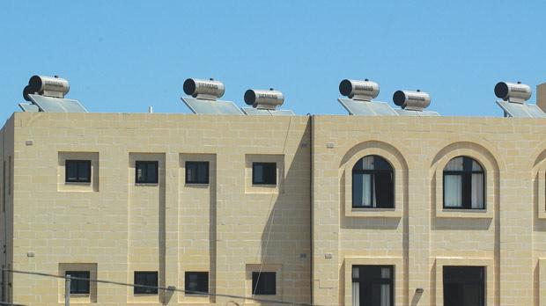
What about renewables and energy efficient systems?

Slide 11
The most common RES and energy efficient system in Malta and Gozo are: 1. Photovoltaic systems 2. Solar water heating systems 3. Micro wind turbines

Slide 12
Take up of PV grant schemes in Gozo
Description_scheme | Island | Number of grants | Grant Value (€) | kWp of application
2006 PV | Gozo | 1.00 | €1,776.15 | 2.05
2009 PV | Gozo | 6.00 | €18,000.00 | 11.65
2010 PV call 2 ERDF | Gozo | 193.00 | €565,004.13 | 460.74
2010 PV National | Gozo | 1.00 | €3,000.00 | 2.18
2011 PV ERDF | Gozo | 442.00 | €1,310,061.05 | 989.76
2013 PV ERDF | Gozo | 1,509.00 | €3,691,238.44 | 4,389.64
TOTAL |  | 2,152 | €5,589,079.77 | 5,856.02
Total No. of households in Gozo - 11,600

Slide 13
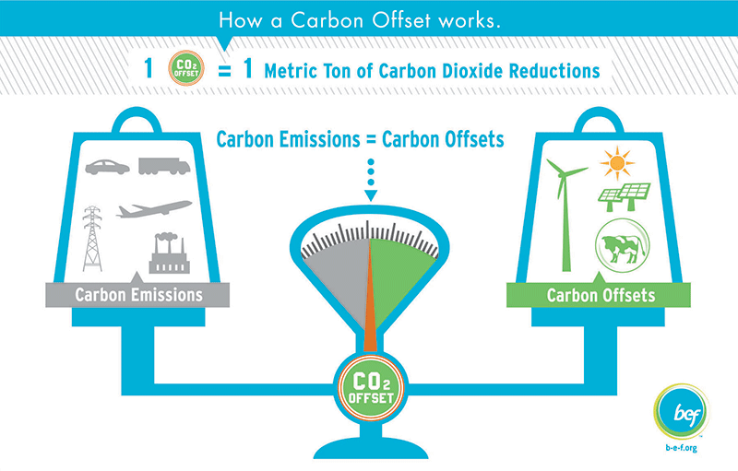
Take up of PV grant schemes in Gozo
Type of funding | Estimated PV Energy generated ( as of end 2014) | Carbon offset ( CO2 e )
Energy Grant Scheme ( grant of 50% to 75%) | 9. 66 GWh per annum | 8,310 Tonnes
Private funding | 3.71 GWh per annum | 3,192 Tonnes
TOTAL | 13.37 GWh per annum | 11,502 Tonnes

Slide 14
Electricity statistics for the Maltese archipelago- 2013
Power generated by power stations - 2013 | 2,216 GWh per annum
Power generated from RES – 2013 | 36.7 GWh per annum
% of RES to fossil | 1.7%

Slide 15
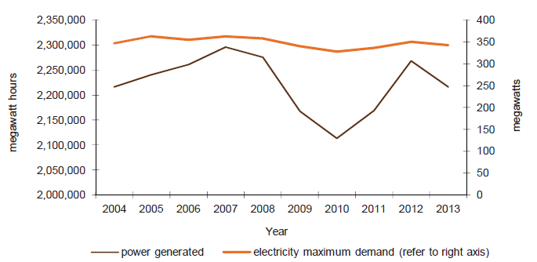
Electricity consumption for the Maltese archipelago 2014 -2013

Slide 16
Plans for the future
Continuation of growth of PV systems in the domestic and commercial sector
Replacement of existing SON street lighting systems with LED technology
Interest by private investors to set up a bio gas facility in Gozo.
Studies currently in progress to assess the feasibility of floating PV farms.

Slide 17
Continuation of growth of PV systems in the domestic and commercial sector
A new scheme for the domestic sector has just been launched in Malta.
The aim is to keep the country on track to reach its energy targets by the year 2020. €15 million of EU funds allocated to three separate schemes, where the finances will be equally distributed. The first strategy is directed at domestic installations of photovoltaic panels which is further divided into two sections. The scheme offers a maximum of €2300, or €750 per kilowatt peak, in order to instigate the maximum use of every roof surface. The Feed in Tariff was announced to be of 16.5 per unit . 7,000 households shall benefit from this scheme.

Slide 18
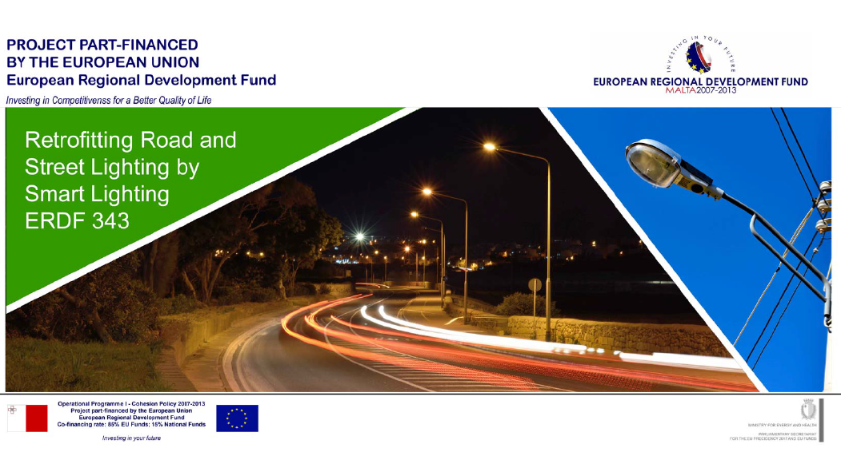
Replacement of existing SON street lighting systems with LED technology

Slide 19
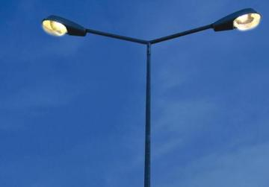
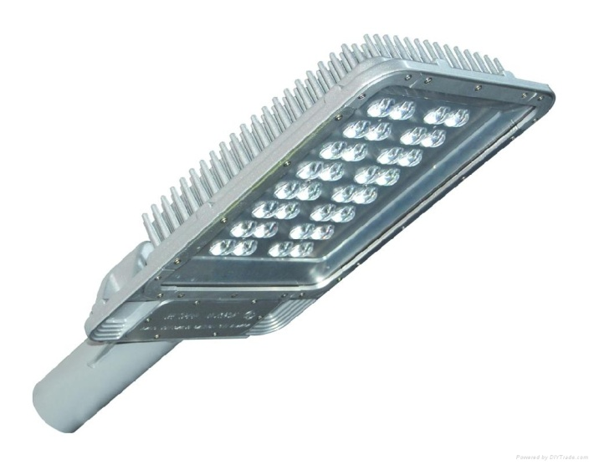
Replacement of existing SON street lighting systems with dimmable LED technology
Existing Lamp technology | Power rating | QTY | New Lamp technology | Power rating | Estimated energy savings per annum | Carbon Offset
SON | 70W | 3365 | LED | 36W | 334,077 kWh | 287,306 kg
SON | 150W | 745 | LED | 85W | 141,401 kWh | 121,604 kg
SON | 250W | 737 | LED | 165W | 182,923 kWh | 157,313 kg
Total |  | 4,847 |  |  | 658,401 kWh | 566,223 kg

Slide 20



Energy related R&D projects in Gozo
Dynamic wind turbine with a higher efficiency over a wider wind speed range.
Overall improvement in efficiency : 15-20%
Project partners:

Slide 21
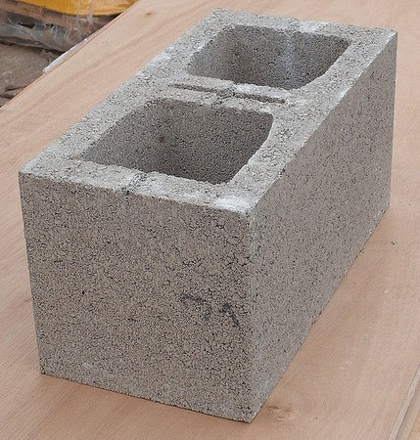


Energy related R&D projects in Gozo
Development of a
hollow concrete block
( HCB) with an improved U-Value of 20-30% over
the conventional HCB
Project partners:

Slide 22
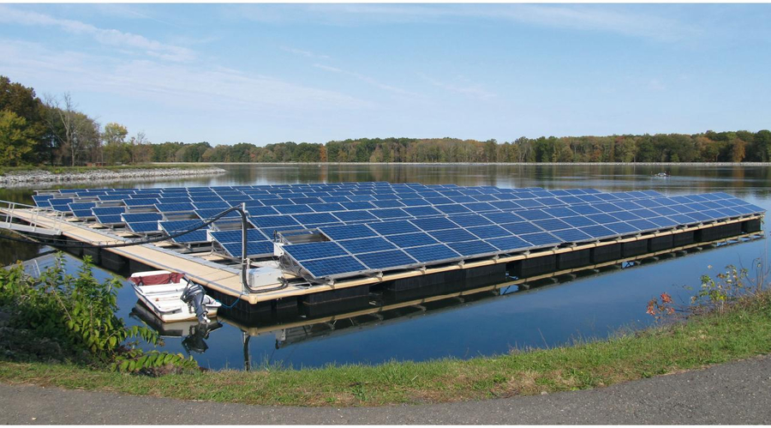
Energy related R&D projects in Gozo
Development of a
Floating PV system
These have been successfully deployed on lakes but the aim is to develop a system suitable fro open seas.
Project partners:

Slide 23
ENERGY UNION AND SMART ISLANDS
Thank You
Questions ?
The Gozo Business Chamber

