Slide 1


  ENERGY UNION AND SMART ISLANDS
  EESC, 10 July 2015
  EUROCHAMBRES
The Association of European Chambers of Commerce and Industry

Slide 2
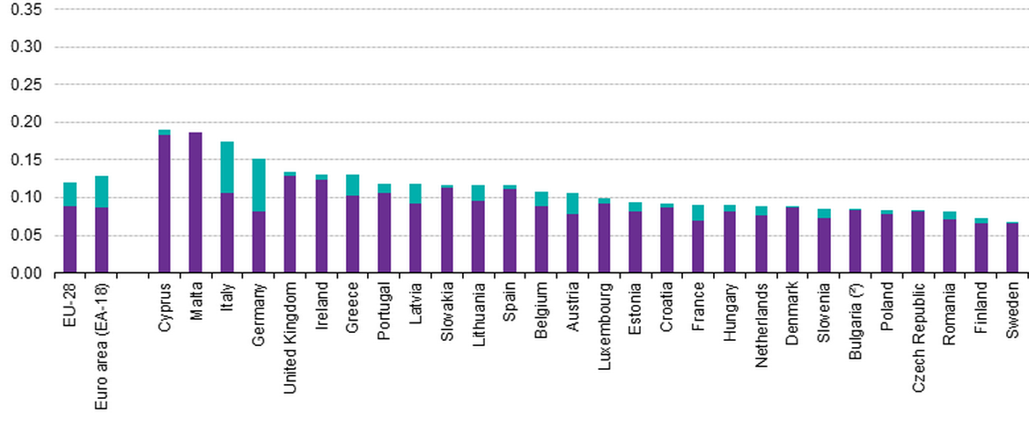

ELECTRICITY PRICES
Electricity prices for industrial consumers, second half 2014 (EUR per kWh)
Challenge 1
Notes:
CHALLENGE 1

Slide 3
INTERCONNECTION
Electricity Interconnection
Member State | Interconnection
Luxembourg | 245%
Denmark | 44%
Greece | 11%
Germany | 10%
France | 10%
Ireland | 9%
Italy | 7%
UK | 6%
Cyprus | 0%
Malta | 0%
Challenge 2
Source: ENTSO-E, Scenario Outlook and Adequacy Forecast 2014
Notes:
CHALLENGE 2

Slide 4
RENEWABLE ENERGY
Share of renewables in gross inland energy consumption, 2013
Member State | Interconnection
EU 28 | 11.8%
Croatia | 16.2%
Greece | 10.7%
Ireland | 6.2%
Cyprus | 6.1%
UK | 5.0%
Malta | 1.5%
Challenge 3
Source: Eurostat
Notes:
CHALLENGE 3

Slide 5
ENERGY UNION
What we support
Focus on energy security, completion of internal market, energy efficiency, decarbonisation, R&I and competitiveness.
Zero tolerance approach on the implementation and enforcement of existing energy legislation
Energy efficiency focus on buildings and transport sector
Renewal of electricity market design
What else do we need?
Clear strategy for ensuring affordable and competitive energy retail prices
- Addressing high taxes and levies
- EU level rules for potential capacity mechanisms
- Harmonised support schemes for renewable energy
EUROCHAMBRES position
Notes:
Modernisation and adaptation of energy infrastructure needs to be top priority (implementation of 3rd internal market package).

Slide 6
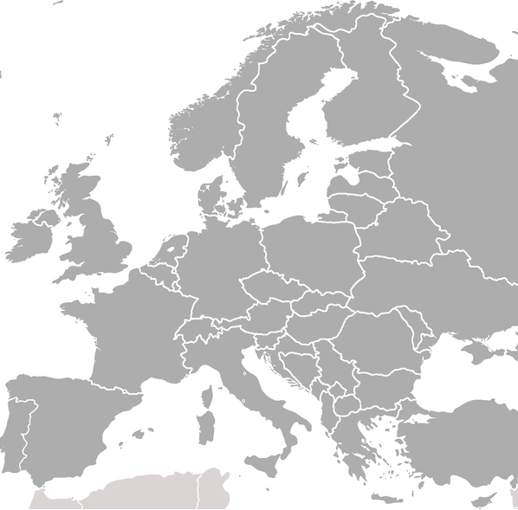






Targeted support for RES

Slide 7
ENERGY UNION
What else do we need?
Recognise importance of fossil fuels for security of energy supply
Global level playing for exporters and energy-intensive businesses
- universal, legally binding climate agreement at COP 21
- robust protection against Carbon Leakage beyond 2020
Cross-sector support for SMEs to become more energy efficient
´- Potential for energy savings between 10% and 20%
- however, SMEs often lack expertise and resources
- Sufficient funding and better financing opportunities are required
EUROCHAMBRES position
Notes:
IEA estimates that EU will need fossil fuels for several decades to come (esp. in industrial and transport sector)

Slide 8
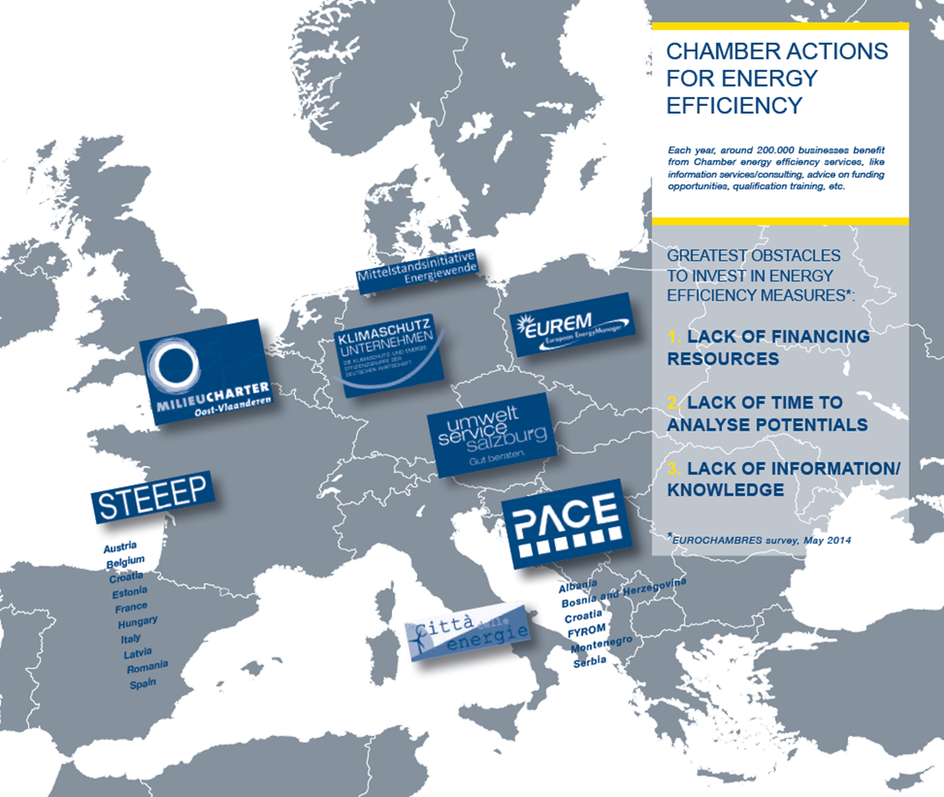

Chamber activities
Untapped potential in the SME sector: 10 - 20%
75% of Chambers provide energy efficiency services:
- basic information
- advice on funding
- training of staff
- on-site support
73% of Chambers have experienced an increase in the demand for energy efficiency services over the last three years

Slide 9
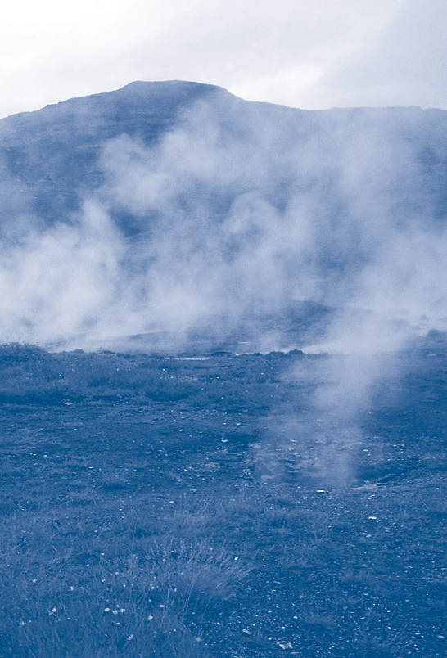

Best practice
Overcoming energy challenges on islands
Hospital in Cyprus
uses geothermal heat for heating system
40 boreholes (each 100 metres deep)
energy savings of 350 MWh per year
additional photovoltaic system (100 kwp)

Slide 10

Thank you for your attention.
CONTACT DETAILS
Michael STEURER
Advisor, EU Affairs
Energy, Climate Change, Environment
Avenue des Arts 19 A-D
B - 1000 Brussels
Tel: +32 (0)2 282 08 77
Fax: +32 (0)2 230 00 38
steurer@eurochambres.eu
www.eurochambres.eu

